Slide 1
Project Name: Drug Effectiveness & Safety Analysis
Role: Data Analyst Intern
Tools: Python (Jupyter Notebook), Tableau

Slide 2
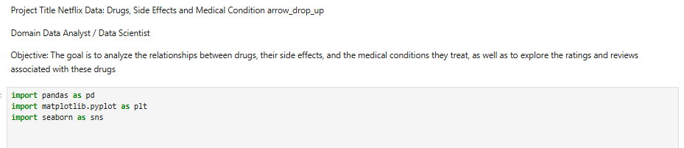
Project Objective
Analyze drug effectiveness using ratings and reviews
Study side effects and medical conditions
Evaluate safety factors like alcohol interaction
Deliver healthcare-focused insights

Slide 3
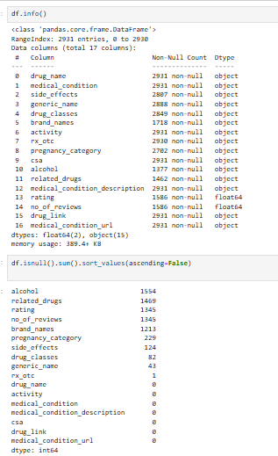
Dataset Overview
Records: ~2,931 drugs
Medical Conditions, Drug Classes, Ratings, Reviews
Rx vs OTC classification
Alcohol interaction and pregnancy category

Slide 4
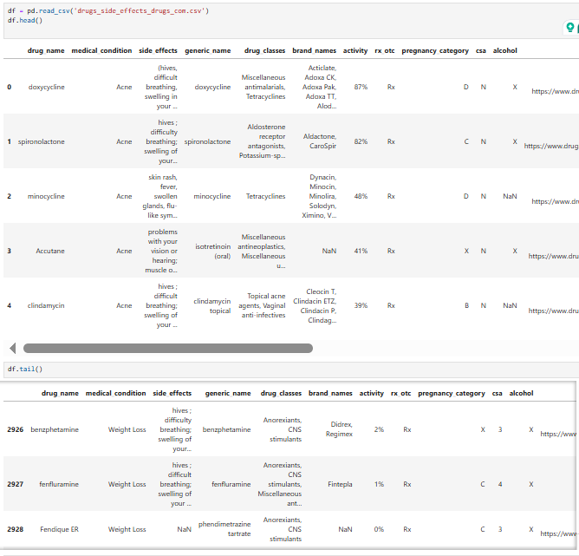
Data Cleaning & Preparation
Handled missing values using meaningful labels
Converted alcohol interaction to binary
Treated ratings & reviews carefully
Ensured clean, analysis-ready dataset

Slide 5
EDA – Dataset Structure in Tableau
Dataset schema, data types, and missing value analysis

Slide 6
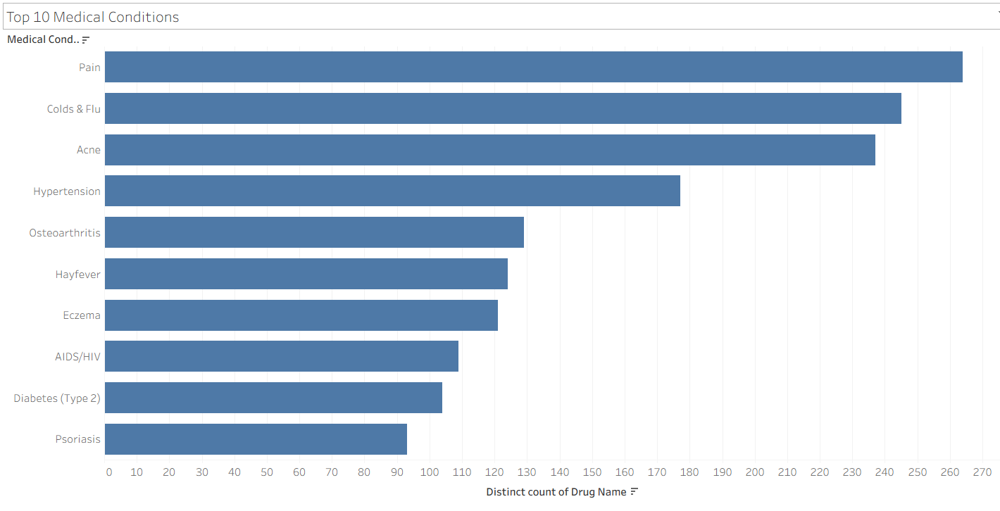
Top Medical Conditions Treated
Pain, Colds & Flu, and Acne dominate medication demand

Slide 7
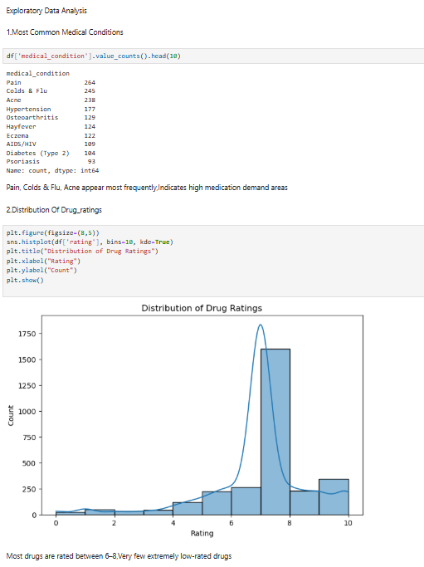
Distribution of Drug Ratings
Most drugs are rated between 6 and 8

Slide 8
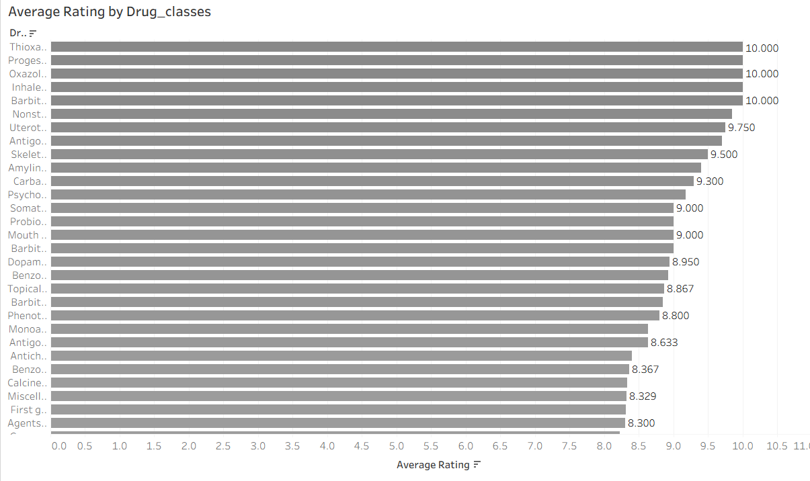
Average Rating by Medical Condition
Niche conditions show higher satisfaction scores

Slide 9
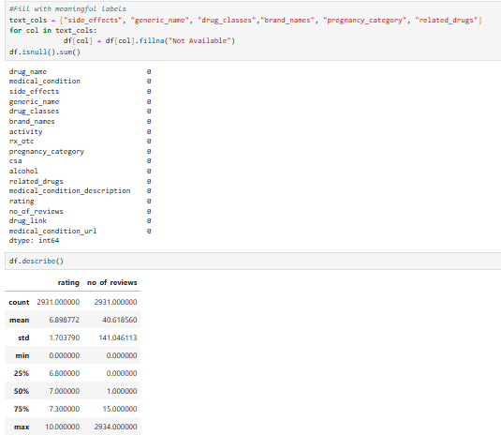
Drug Classes Usage
Upper respiratory and topical agents dominate

Slide 10
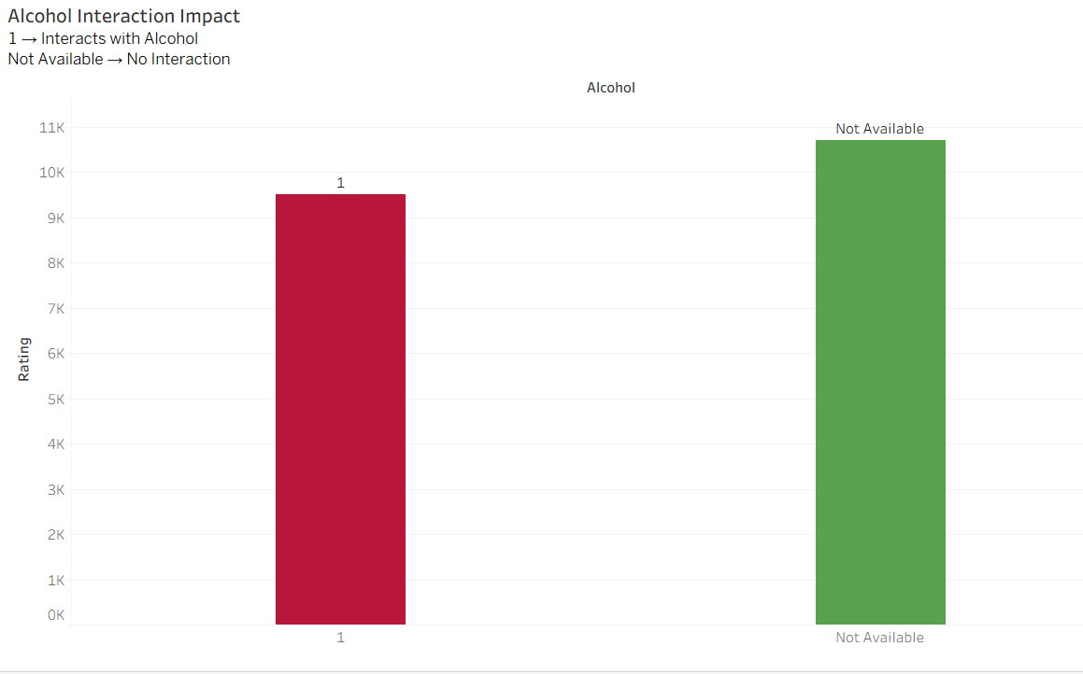
Alcohol Interaction Impact
Alcohol interaction slightly impacts drug ratings

Slide 11
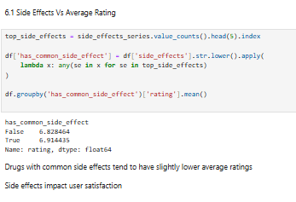
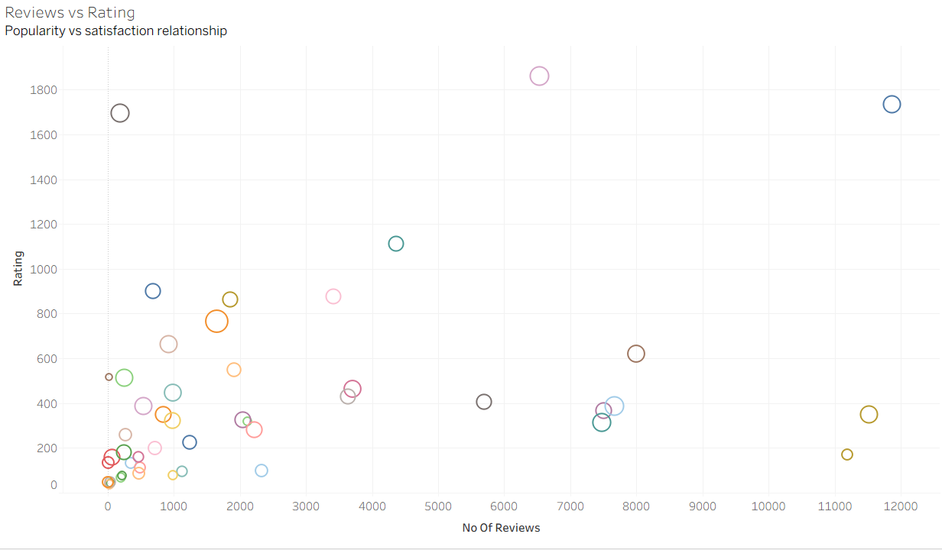
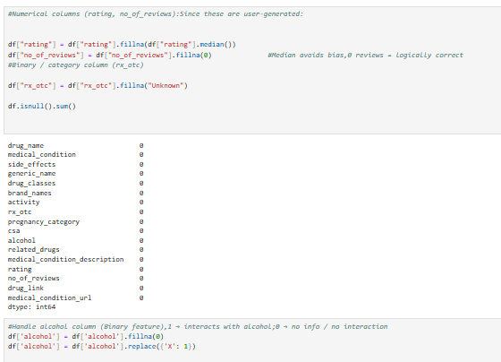
Popularity vS Satisfaction relationship
Alcohol interaction slightly impacts drug ratings

Slide 12
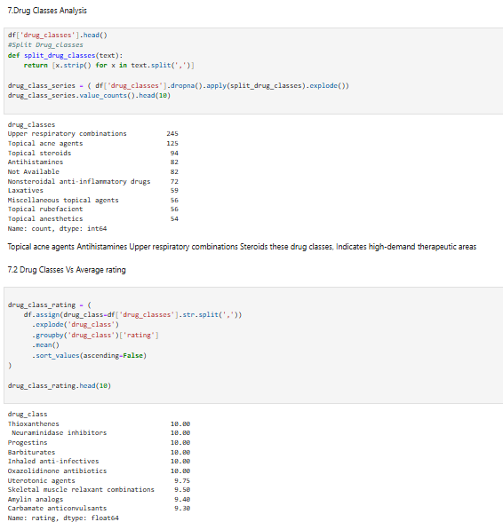
Drug Classes Analysis
Alcohol interaction slightly impacts drug ratings

Slide 13
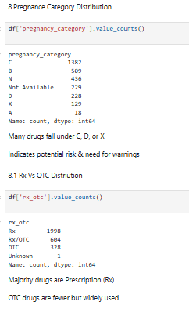
Pregnancy Category Distribution
Alcohol interaction slightly impacts drug ratings

Slide 14
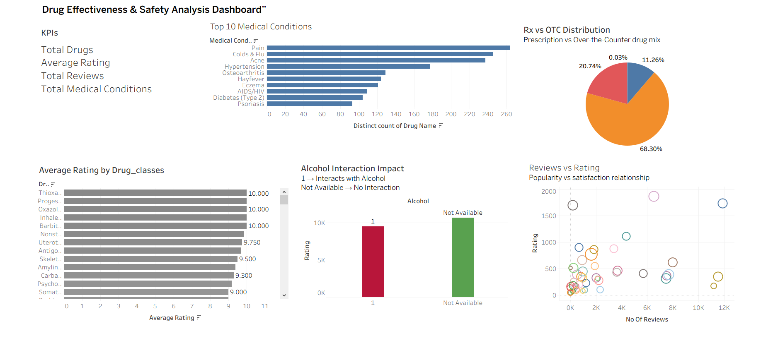
Tableau Dashboard – Overview
Interactive dashboard combining safety, ratings, and usage

Slide 15
Key Business & Healthcare Insights
High demand for pain and flu medications
Safety factors influence user ratings
Rx drugs dominate the market
Reviews provide valuable real-world feedback
Conclusion
End-to-end healthcare analytics project
Python for EDA and statistical insights
Tableau for decision-ready dashboards
Demonstrates real-world domain understanding

Slide 16
THANKYOU

